Slide 1
Interactive Maps
Design Overview
Design of testing

Slide 2

Design Overview
Prior to input compilation, all vertices will be colored black to facilitate the starting state of the interface.
After the inputs have been compiled, the starting and ending nodes will respectively turn green and red to visually identify them.
The path between the two points will be shown by the edges that illuminate and turn white to provide clear and concise guidance.
Intermediate nodes will turn orange to indicate their significance as part of the selected route.

Slide 3

The interface will display the shortest distance calculation at the bottom to inform users of the expected journey time.
The path, along with the vertices involved, will be illustrated using arrows in textual format to provide a comprehensive overview of the selected route.
Users will have the option to modify their route based on selected street typologies while still receiving the shortest path recommendation using the specified streets.

Slide 4
Functions to be used
Dijkstra’s algorithm
Draw_graph
Reset_graph
Color_path
Draw_edge & draw_node
Draw_edge_label
Class DijkstraGUI
Run_algorithm

Slide 5

pseudocode & description in words
Define function generate_random_graph(num_nodes) to generate a random graph
Define function measure_runtime(random_graph, start, end) to measure the runtime of Dijkstra's algorithm on a given graph and start/end nodes
Define function run_tests(min_nodes, max_nodes, step) to run tests on Dijkstra's algorithm for different number of nodes in the graph
Define function plot_results(runtimes) to plot the results of the runtime tests
Call run_tests and plot_results in the main function with specified parameters.

Slide 6
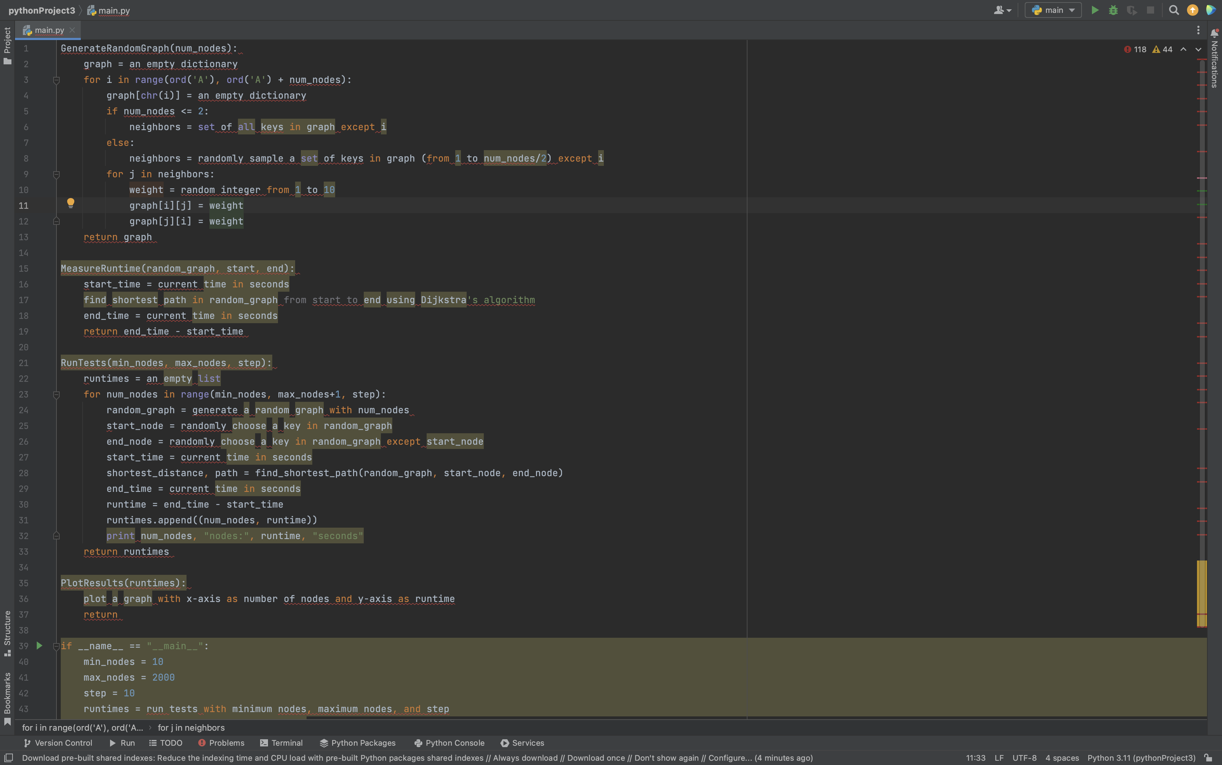

Slide 7
GenerateRandomGraph(num_nodes): This function takes an input of number of nodes and generates a random graph with those nodes. The graph is represented as a dictionary where each key represents a node and the corresponding value is another dictionary that contains the node's neighbors as keys and the weight of the edge connecting the node to its neighbor as the value. The function generates random weights for the edges, and ensures that each node has at least one neighbor.
MeasureRuntime(random_graph, start, end): This function takes a random graph generated by GenerateRandomGraph, a starting node, and an ending node as inputs. It measures the time it takes to find the shortest path between the start and end nodes using Dijkstra's algorithm. It returns the runtime in seconds.
RunTests(min_nodes, max_nodes, step): This function generates random graphs of increasing sizes (starting from min_nodes and increasing by step until max_nodes) and measures the runtime of Dijkstra's algorithm on each of them. It appends the runtime of each test to a list and prints the number of nodes and the corresponding runtime. It then returns the list of runtimes.
PlotResults(runtimes): This function takes the list of runtimes generated by RunTests and plots a graph where the x-axis represents the number of nodes and the y-axis represents the runtime.
The if name == "main" block sets the minimum and maximum number of nodes for the test, as well as the step size. It then runs the tests using RunTests and plots the results using PlotResults.
Overall, this code is used to test the performance of Dijkstra's algorithm on random graphs of increasing sizes, and plot the results to observe how the algorithm's runtime varies with the number of nodes in the graph.

Slide 8

Testing
To evaluate the performance of our graph algorithm, we conducted experiments during the testing phase.
We utilized the ‘testing.py’ script to run our experiments on graphs of different sizes.
We tested the algorithm on graphs with nodes ranging from 10 to 2000.
This helped us to examine the impact of the graph size on the execution time of the algorithm.
For each graph size, we created a random graph with random edges and neighbors for each node.
We then calculated the time required by our algorithm to process each graph.
Finally, we recorded and documented the results of the experiments.

Slide 9
Python script that generates a random graph with a given number of nodes and edges.
Implement the graph algorithm in Python and making sure it can take a graph as input.
A function that measures the time taken by the algorithm to process a graph.
A script that runs your algorithm on graphs with varying numbers of nodes and records the execution times.
Using a plotting library like matplotlib to plot the execution times against the number of nodes.
Analyzing the results and draw conclusions about the performance of the algorithm.
Repeat the process with different graph sizes and parameters to gather more data and verify the results.
Document the testing process and results thoroughly to ensure that others can reproduce and validate the findings.

Slide 10
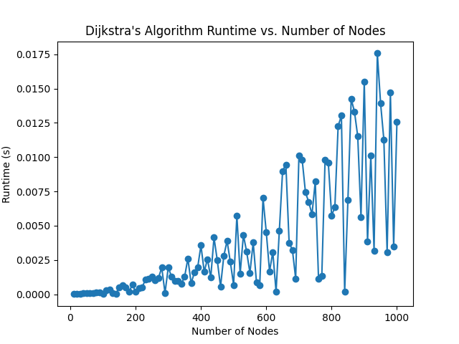

Slide 11

Goals to be reached
The bike routing system will take user input for the starting point and the destination point.
The system will use Dijkstra's Algorithm to find the shortest and safest route between the two points.
The system will display a map of Kalamazoo and Portage, Michigan, with all vertices (e.g. intersections, landmarks) labeled and all edges (e.g. roads, bike paths) displayed with their weights/distance.

